Slide 1
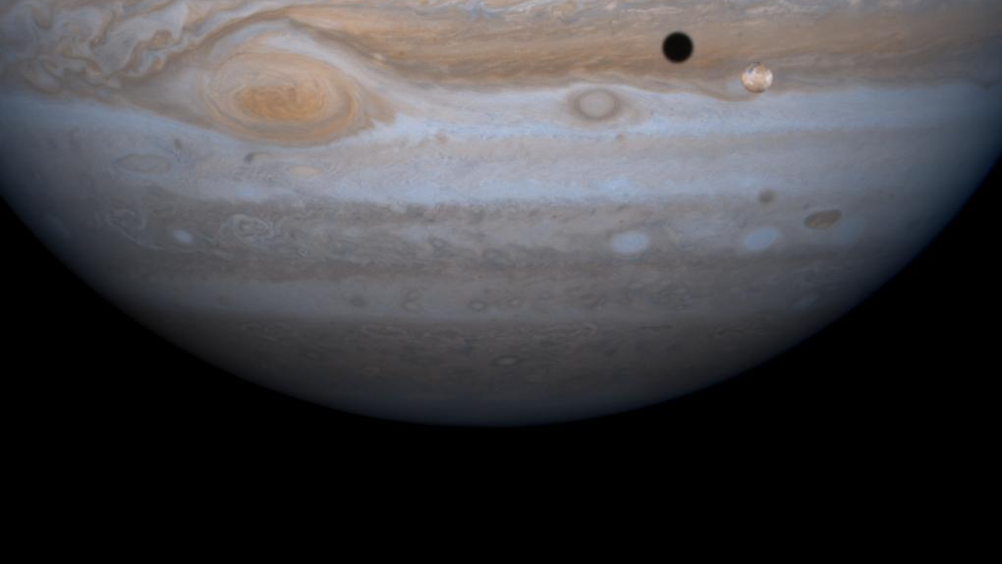
Tools and Techniques for a Jupyter Based Scientific Workflow
2022/3/7
Image Credit: NASA

Slide 2





Tasks
Write
Document
Communicate
Reproduce
Audit

Slide 3
Tasks
Write
Document
Communicate
Reproduce
Audit

Slide 4
Tasks
Write
Document
Communicate
Reproduce
Audit

Slide 5
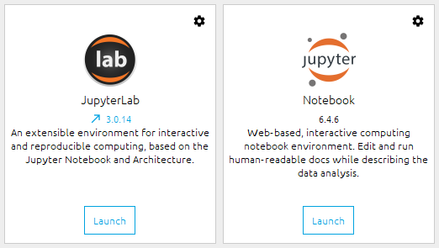
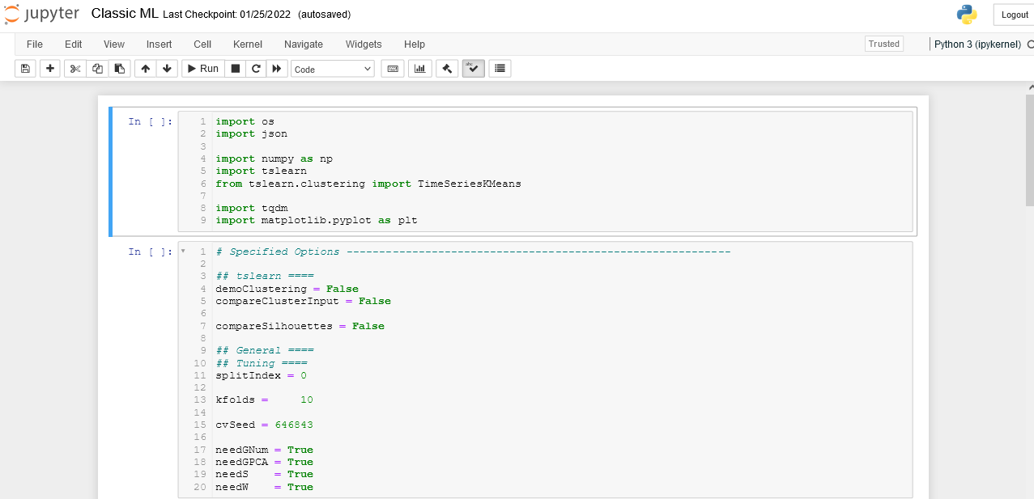
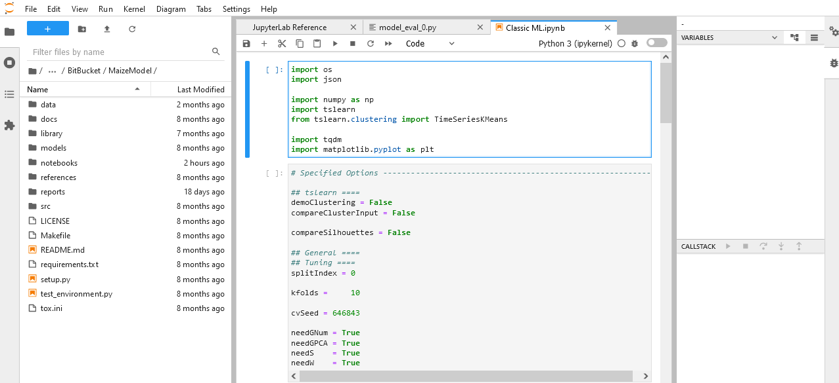
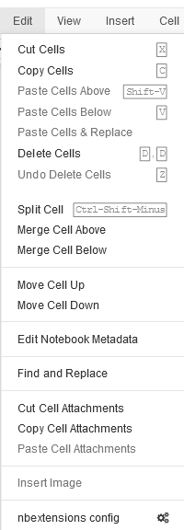
Notebooks
Jupyterlab
Multiple files (!)
File browser
Plugins
Debugger
Limited at first, but customizable through extensions
More feature rich out of the box, akin to Rstudio or PyCharm.
Both are good options.
Try both and don’t be hesitant to switch if you’re for a feature only one has.

Slide 6
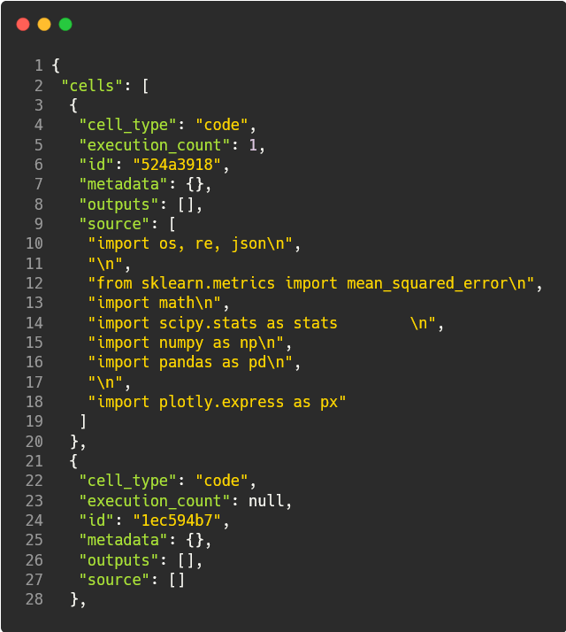
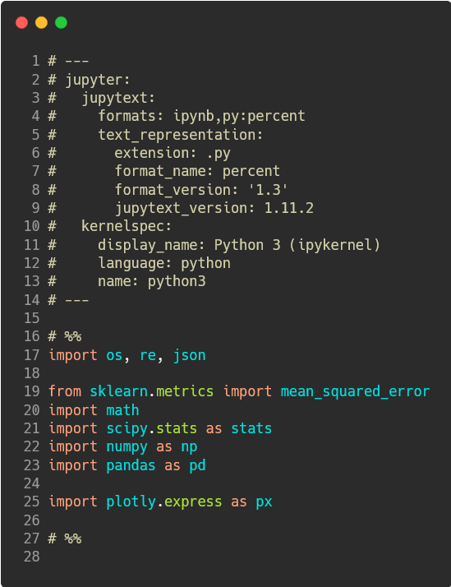
Using Jupyter Effectively
Find shortcuts for common tasks. (e.g. ctrl+/ → comment code)
Additions to consider:
Jupytext (automatically backs up foo.ipynb as foo.py , great for git)
Organization
Table of Contents (2)
Collapsible Headings
Codefolding
View/Toggle Line Numbers
Writing
Autopep8 (auto format python code)
Spellchecker
Hinterland (code completion)
Presentations
RISE (html slides, works with plotly)

Slide 7

Useful Habits
Your closest collaborator is yourself – six months ago
Libby King (paraphrased)
Code should focus on being clear first.
Writing out what your code needs to do is a great way to plan while documenting your code.
Markdown blocks (esc+M) are good way to break up code with human readable headings and explanation
Err on the side of writing too many comments.
The “why” and “how” of the code. Eventually may shift towards concepts from mechanics.

Slide 8
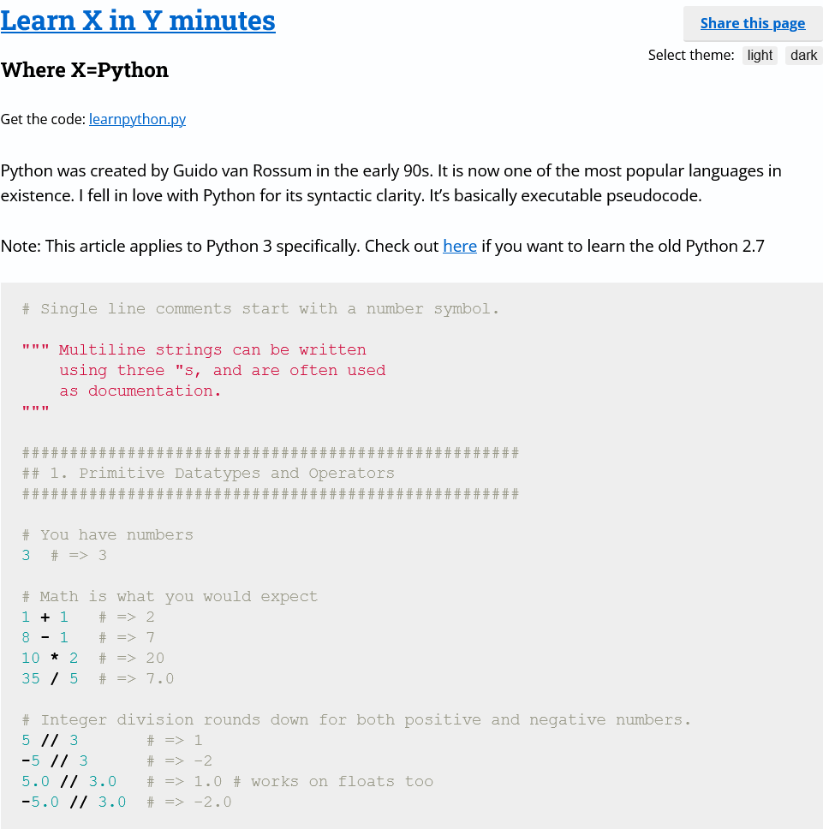
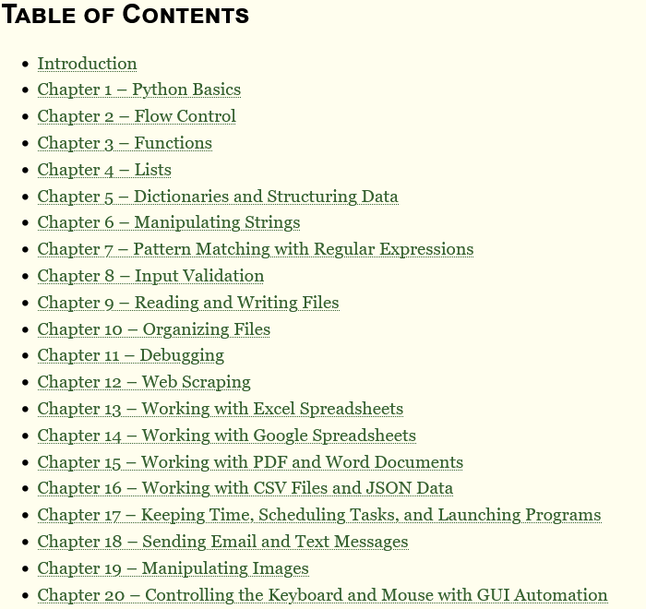

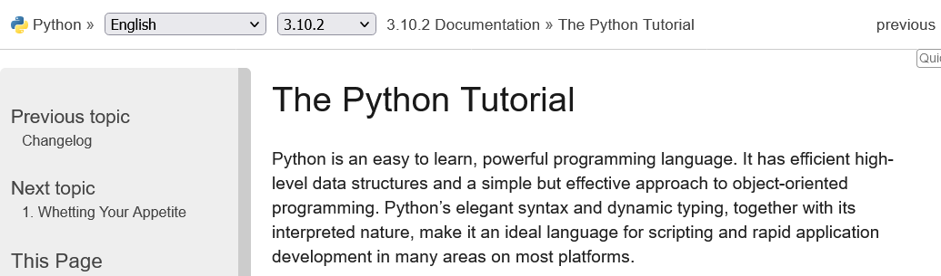
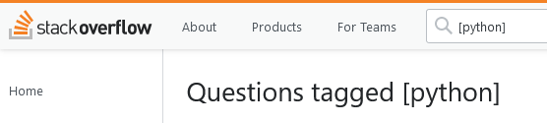
Getting help
Tutorials
Learn X in Y minutes
Automate the Boring Stuff
Software Carpentry
Data Carpentry
Official Tutorial
Specific Questions
Stack Overflow
Lab members!

Slide 9
Tasks
✔
Write
Document
Communicate
Reproduce
Audit
✔

Slide 10
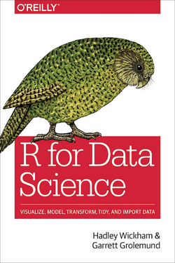
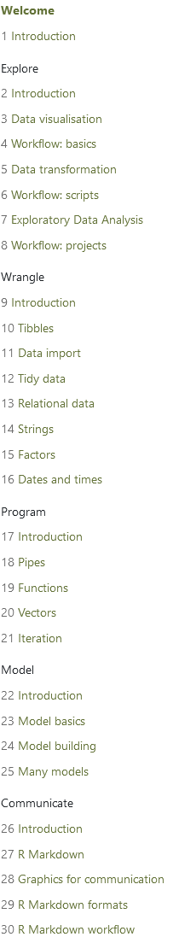
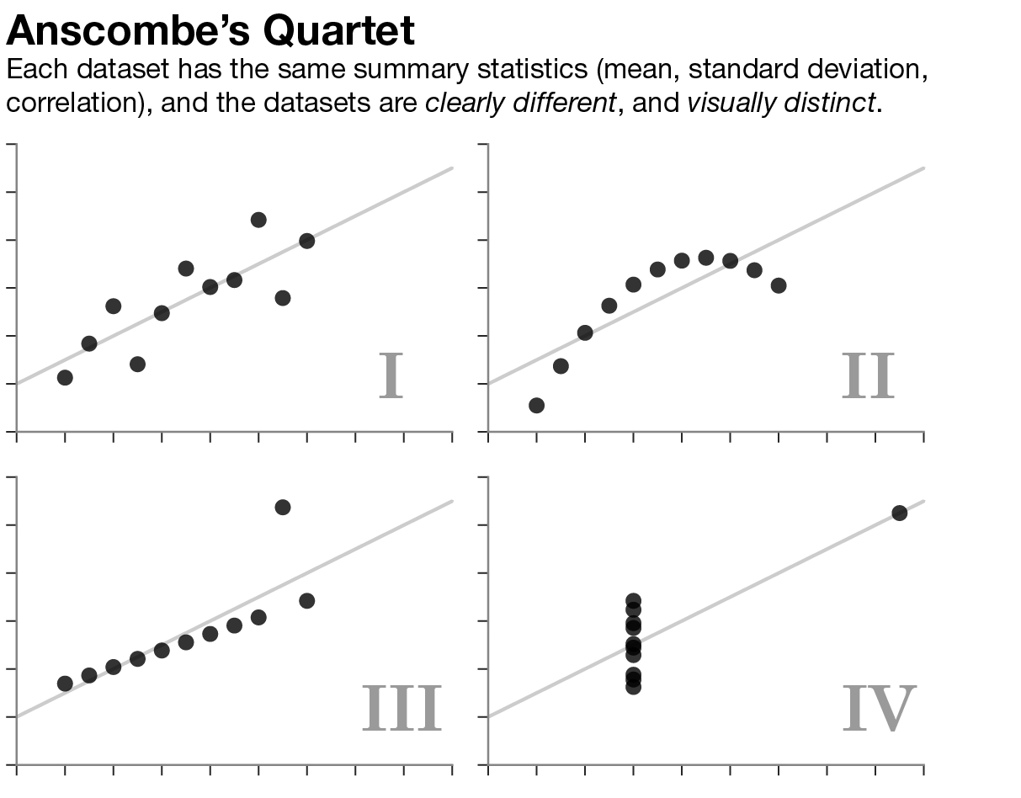
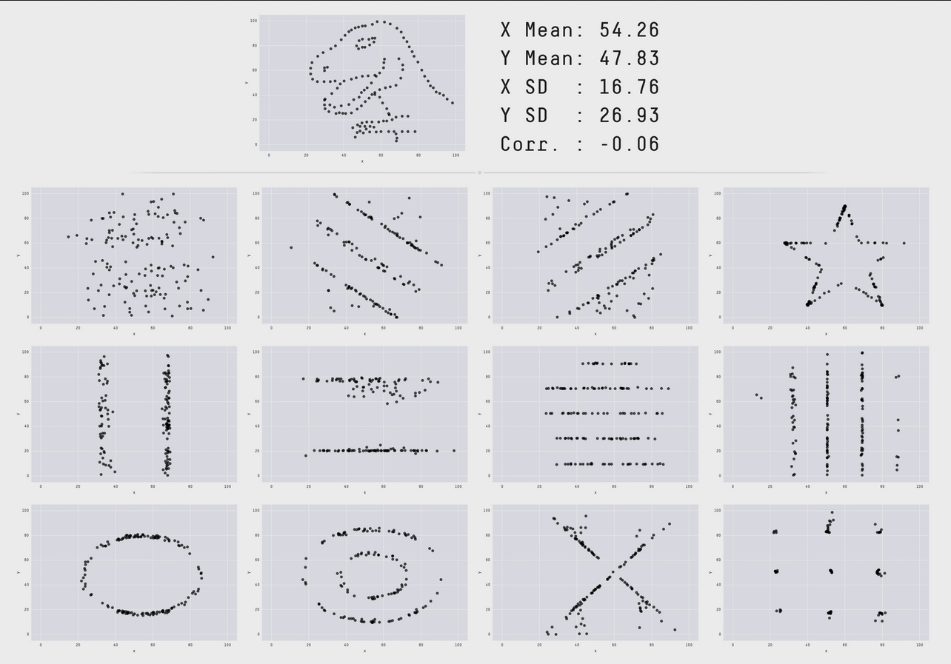
Visualization occurs throughout analysis
R for Data Science
Quickly see the effect of changes code
Leverage visual intuition to spot patterns/outliers
Source: Autodesk

Slide 11

Comparing Python Graphing Libraires
Great for interactive figures
Bindings for python, R
Allow for interaction at a high level (figure factory, plotly express) and a low level (graph objects)
plotly
Seaborn is built on matplotlib.
Great for statistical plots -- if they have what you want.
seaborn
Great for very simple and very complex plots
matplotlib
Fans of ggplot2 can use plotnine which operates almost identically

Slide 12
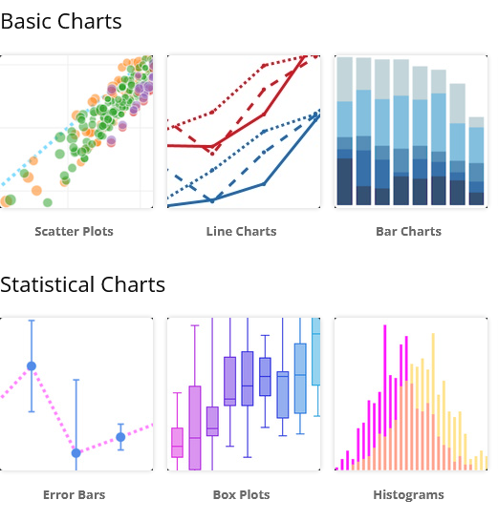
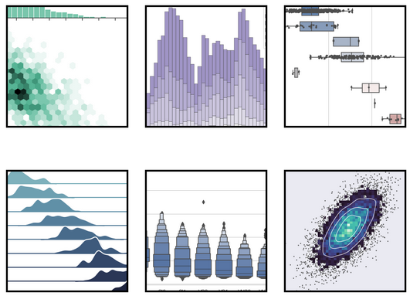
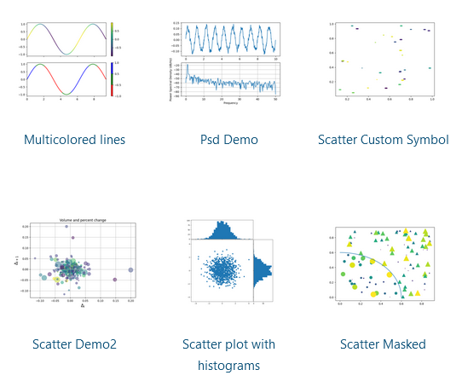
Comparing Python Graphing Libraires
High and low level controls provides
a nice balance of customization and
Speed.
Very nice out of the box but
customization requires mpl
Highly customizable but not
particularly user friendly*
*ymmv, relative to ggplot2

Slide 13
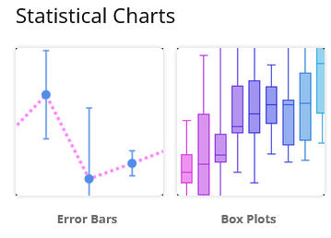
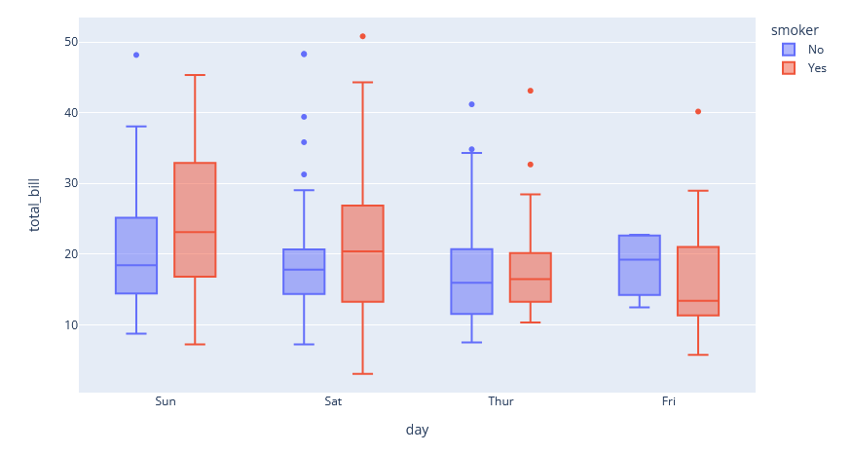
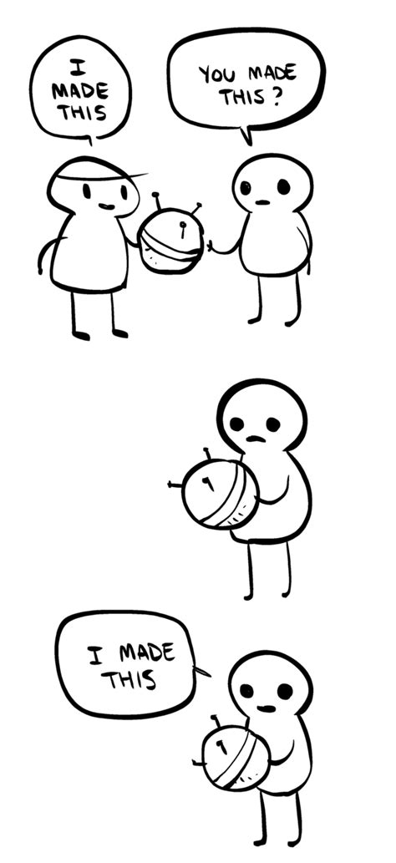
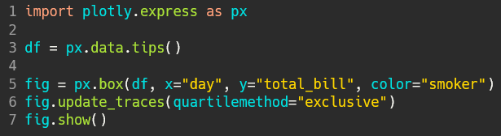
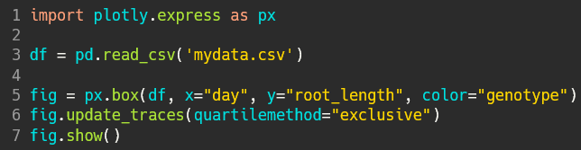
Plotly – Getting started
Choose a chart
Copy the example code
Test the example on your machine
Swap in your variables and data.

Slide 14
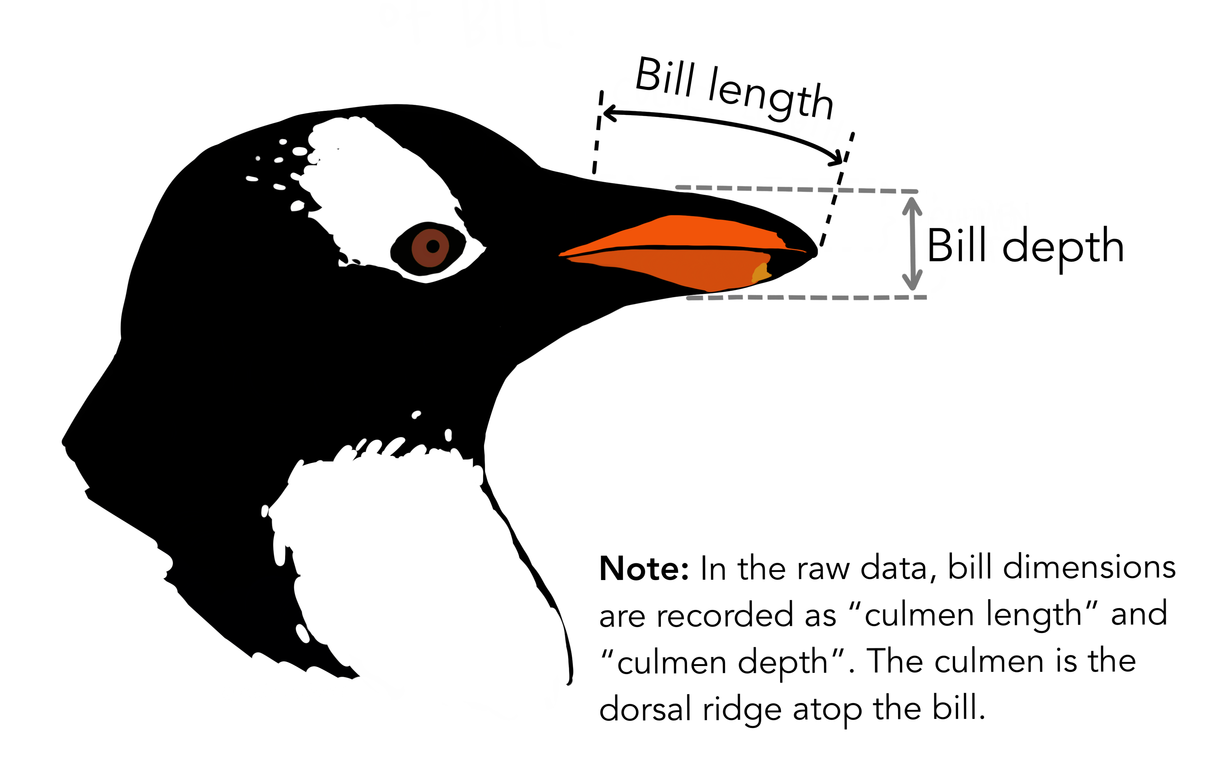
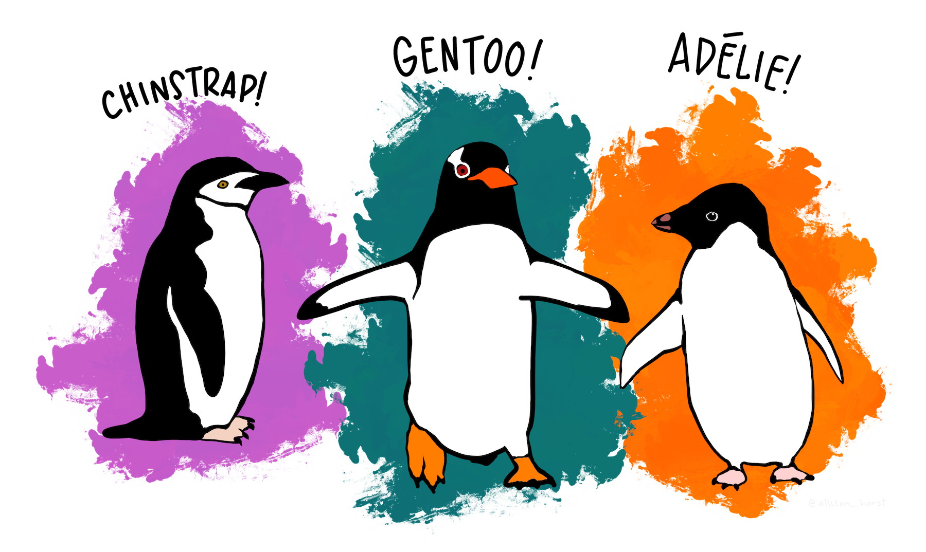
Plotly – Digging Deeper
Plotly express – Main interface
Figure factory – Specialized figures built from graph objects
Graph objects – More detailed control of plots
Palmer Penguins

Slide 15
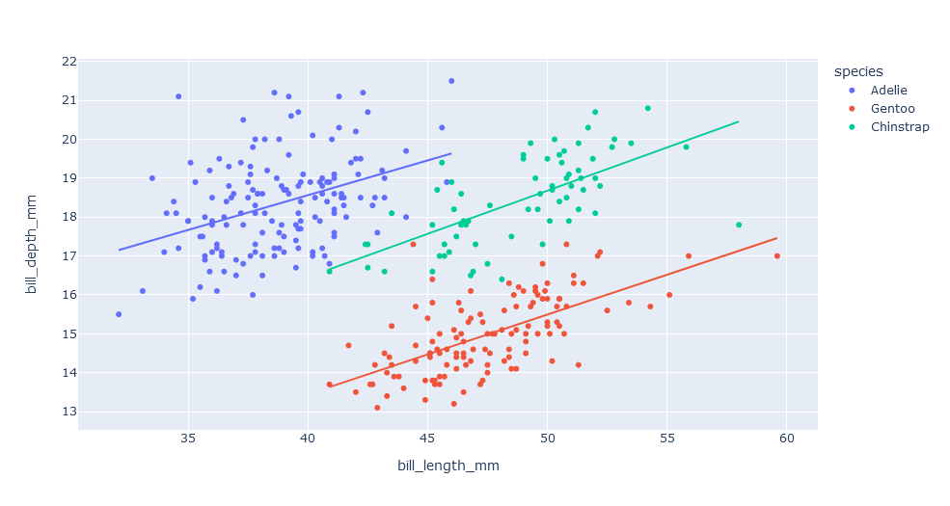
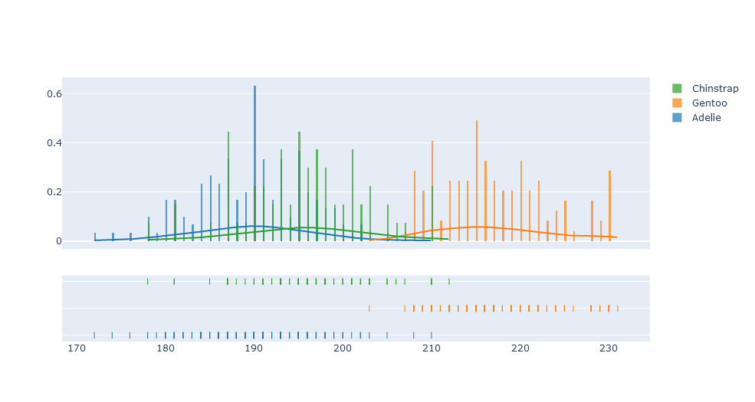
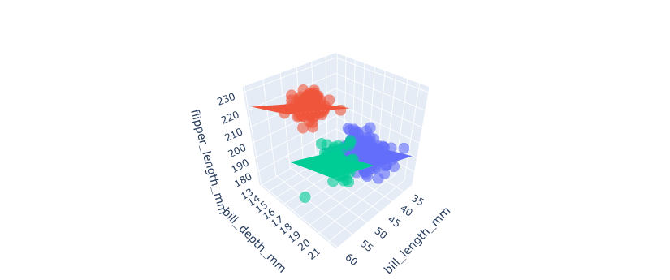
Plotly – Digging Deeper
Plotly express – Main interface
Figure factory – Specialized figures built from graph objects
Graph objects – More detailed control of plots
Palmer Penguins

Slide 16
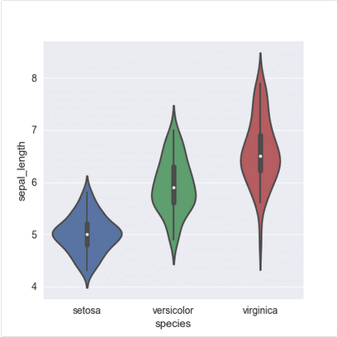
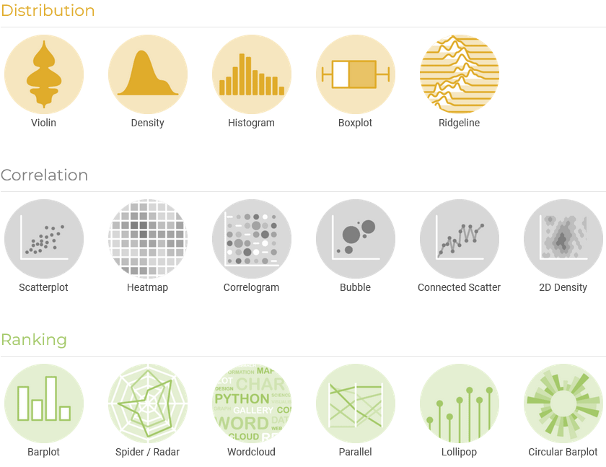
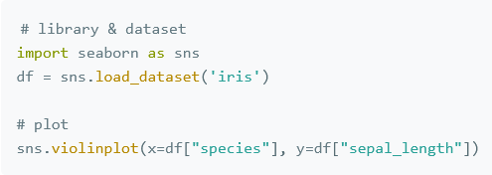
Other resources
Python Graph Gallery

Slide 17
Tasks
✔
Write
Document
Communicate
Reproduce
Audit
✔
✔

Slide 18
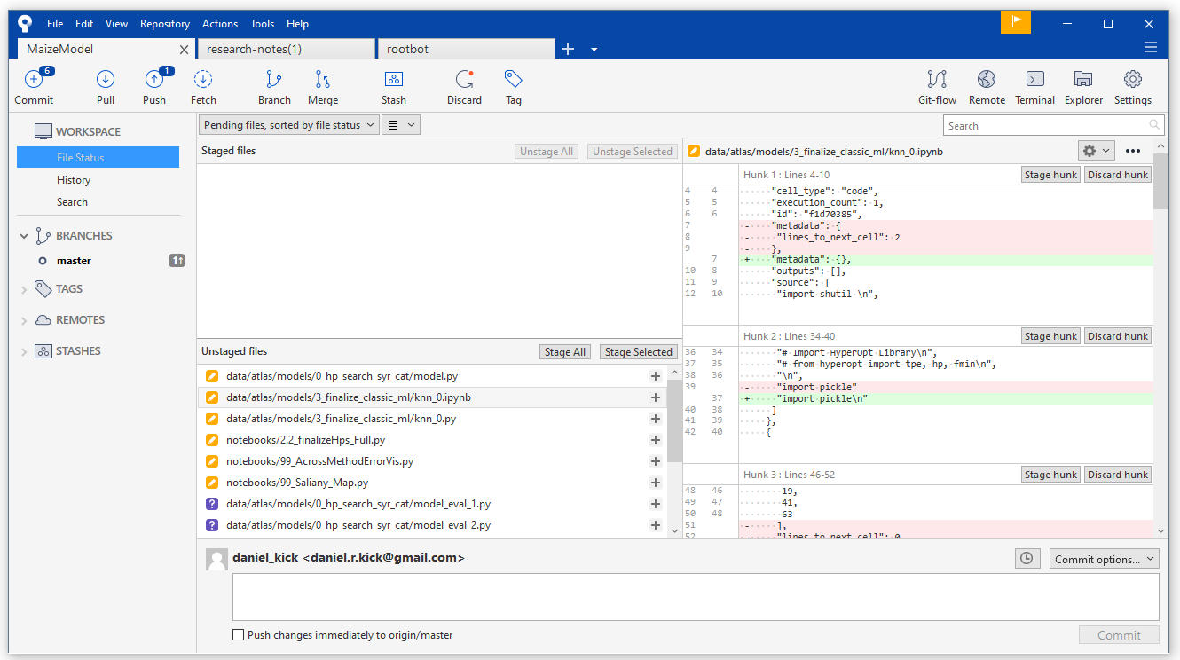
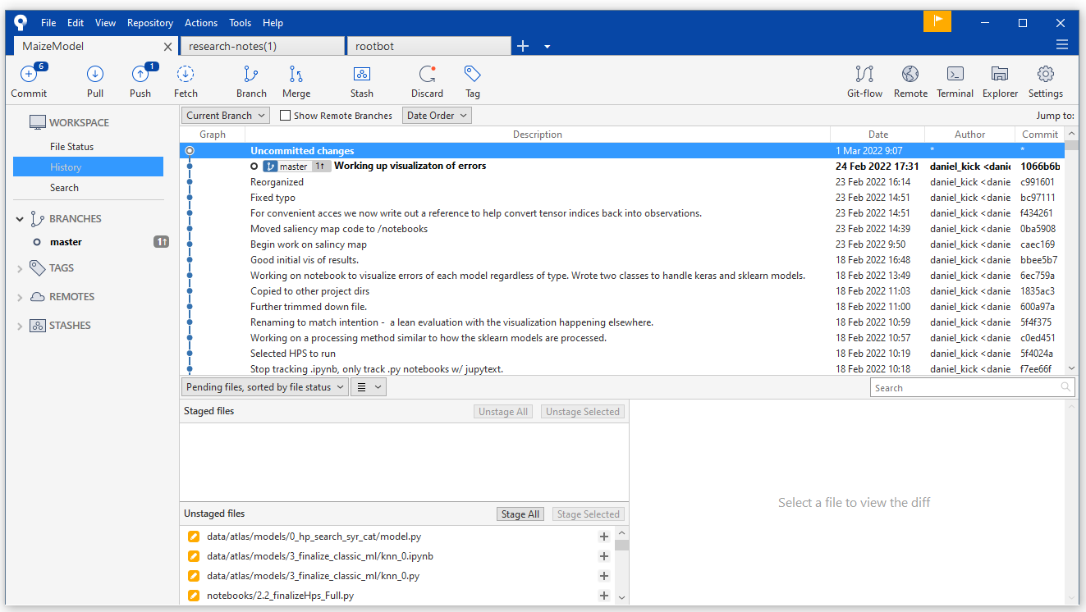
Git
Changes
(this is why paired notebooks are useful)
Backup snapshot
Track changes + backup
Useful even if you’re the only one working on a project
Ways to track packages in addition to code
Virtual environments
Conda virtual env
Docker/Singularity
Scinet Overview
Files with changes
New files not yet tracked
Capture a “snapshot”
Description of what changed
History of snapshots

Slide 19
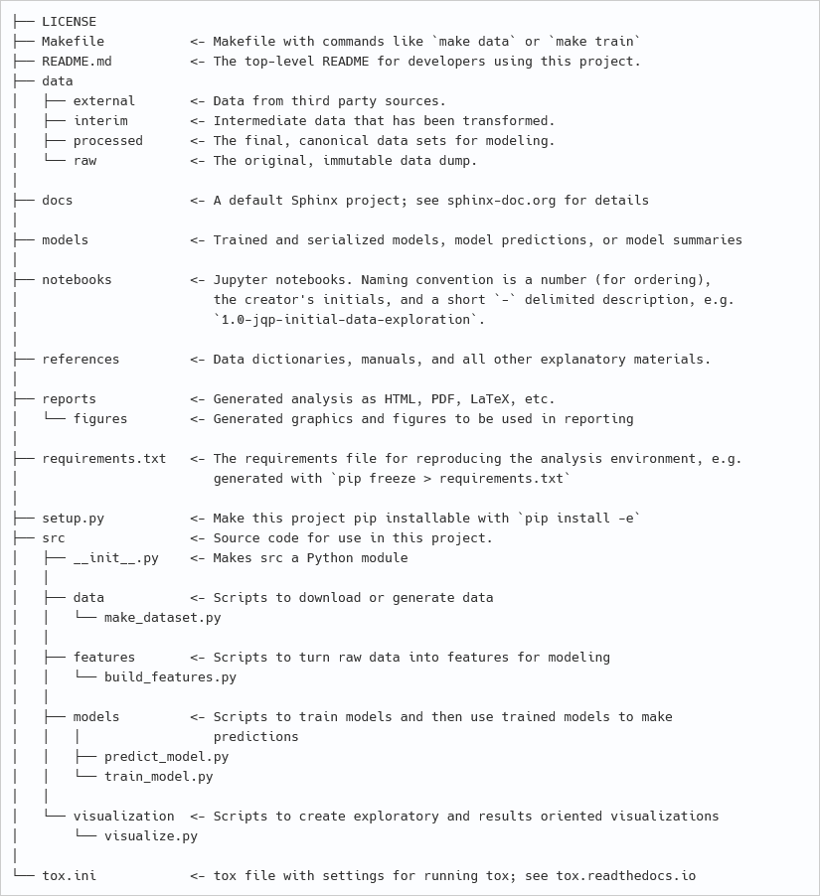
Think about the project structure before starting
Cookiecutter data science structure
R packages or similar
The more moving parts the more important this is.

Slide 20
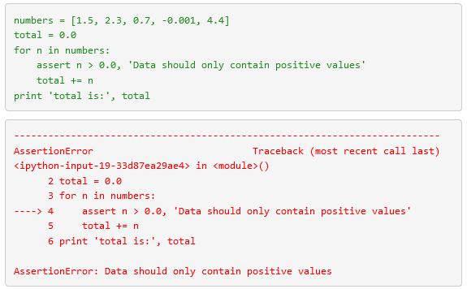
Assertions
“It ain’t what you don’t know that gets you into trouble. It’s what you know for sure that just ain’t so.”
Defensive Programming
More Formal options:
Great Expectations (data)
Hypothesis

Slide 21
Tasks
✔
Write
Document
Communicate
Reproduce
Audit
✔
✔
✔
✔

Slide 22
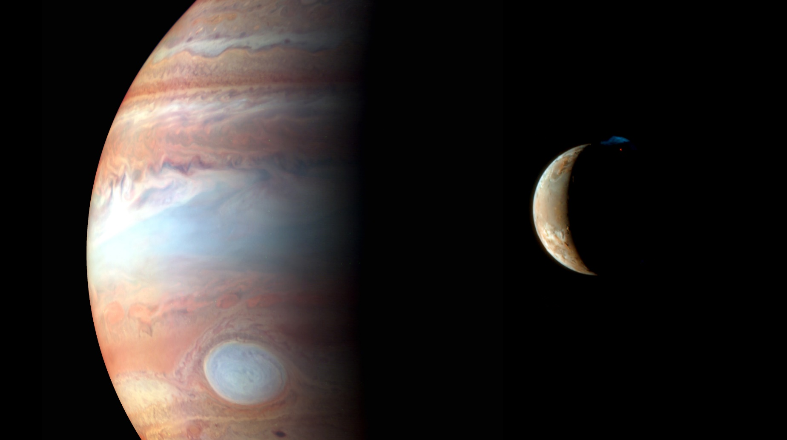
Image Credit: NASA

